Slide 1
Use ACL2 to Prove the Correctness of Clebsch-Gordan Coefficient
Xiaohui Chen
04/20/2015

Slide 2
Timeline
04/13/2015-04/19/2015
Finish coding and finish verify the theorem
04/20/2015-04/26/2015
Finish proving the main theorem
Finish project report (first draft) and presentation slides
04/26/2015-05/03/2015
Finish presentation and modify project report
Finish final draft of project report by 05/06/2015

Slide 3
My model
((A . (j . m_j)) .
((B . ((l . m_l) . (s . m_s)))
(C. ((l . m_l) . (s . m_s)))
….))
We have to verify that after a series of operations on the above pair, A=B+C+D+...

Slide 4
Progress
Finished proving the lemmas. Beginning proving the main theorem
Finished optimizing some of the lemmas
Some of them still have a lot of splitting, but way better
The proving time is endurable

Slide 5
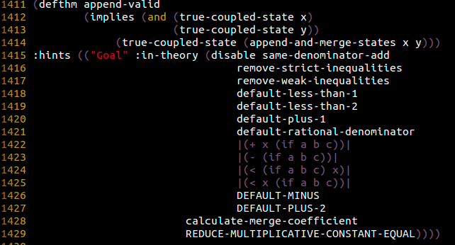
This was the theorem which took more than 80,000,000 steps and 15 minutes

Slide 6
(defthm append-valid
(implies (and (true-coupled-state x)
(true-coupled-state y))
(true-coupled-state (append-and-merge-states x y)))
:hints (("Goal" :in-theory (disable same-denominator-add
remove-strict-inequalities
remove-weak-inequalities
merge-same-property-4))))
This theorem takes more than 84,000,000 steps, 983 seconds

Slide 7
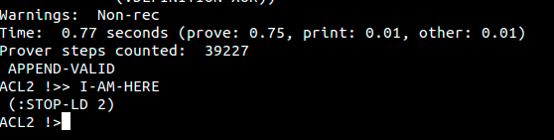
NOW

Slide 8
Inspect the if-intro and disable all the splits
Gradually enable back the if-intros
Use lemmas that could minimize the splits
Sometimes proof-checker is more convenient

Slide 9
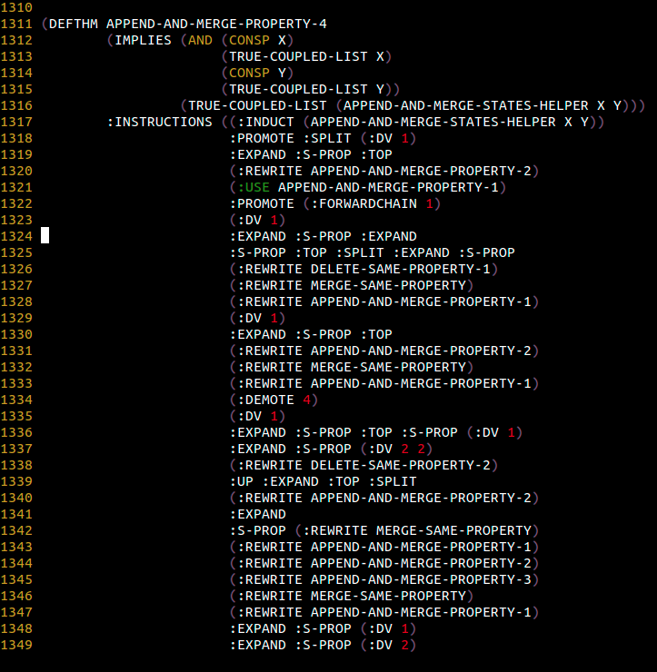

Slide 10
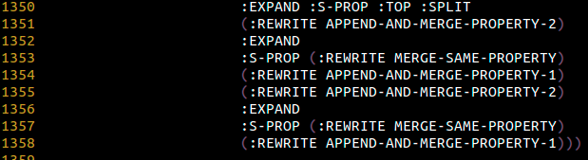

Slide 11
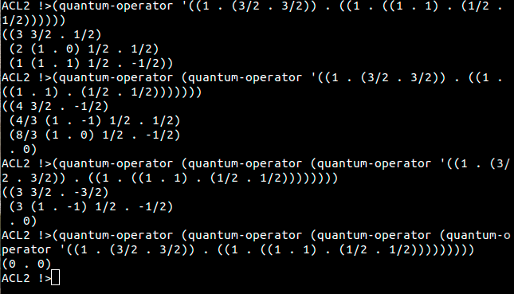
Result

Slide 12
Prove
Given an initial state, all the outputs subsequent operations
either have A=B+C+D... or
equal to (0 . 0) for the operations on the lowest states
This ought to be done around Wednesday and Thursday!!!!

Slide 13


